Slide 1

Predicting the Number of Subscriber for 10k Development Courses
Reem Bin Obaidan

Slide 2
INTRODUCTION
The last few years have seen an upward growth in the popularity of e-learning and e-learning methods. This has been possible due to our dependency on the digital lifestyle and the cost-effectiveness of the plans.
World had come face-to-face with the pandemic of Covid-19, the growth of e-learning has increased tenfold. From students to professionals, everyone is using digital mediums to add new skills to their knowledge .

Slide 3



Analyzing & Visualization
What are the most popular courses?
What courses offer the best cost benefit?
What are the most engaging courses?

Slide 4
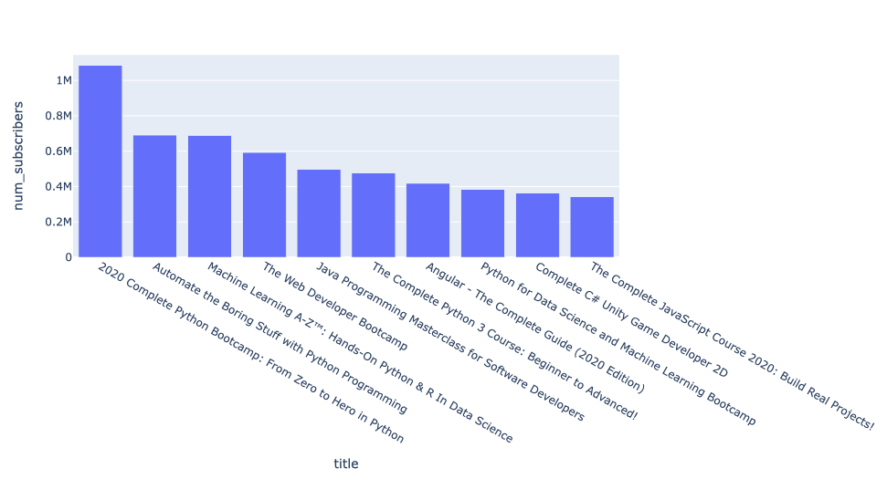
Most Popular Courses

Slide 5
Best Cost Benefit
cost_benefit =
course price <=average course price
And number of subscriber >= average number of subscriber
The course which offers the best cost benefit is:
Automate the Boring Stuff with Python Programming
Learn HTML5 Programming From Scratch
Python for Absolute Beginners
Data Analysis with Pandas and Python
Learn Ruby on Rails from Scratch

Slide 6
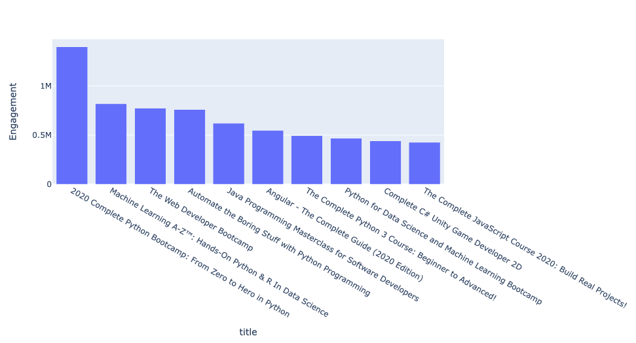
Engaging Courses
Total engagement = number of subscribers
+ number of reviews.

Slide 7
Predictive Analysis
Regression models :
To:
Everyone
More
Support Vector Regression
Linear Regression
Random Forest Regressor
Kernel Ridge Regression
Gradient Boosting Regression
Elastic Net Regression
Type message here...

Slide 8
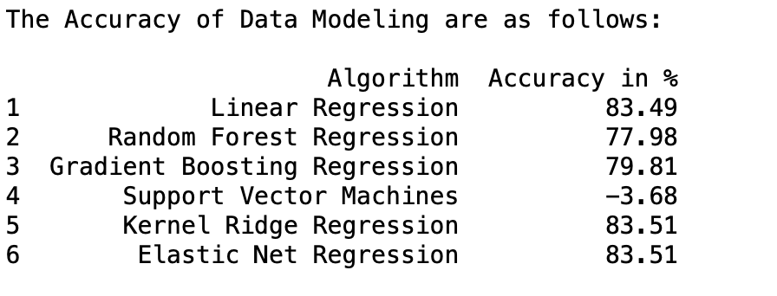
Cross Validation
Among all the algorithms we notice that Linear Regression ,Kernel Ridge Regression, and Elastic Net Regression are of utmost accuracy. Therefore, we can use either one of them to predict the number subscribers.

Slide 9
Thank you !

